Slide 1
BIKE USAGE TRENDS FOR THE YEAR.
Cyclistic Bike-Share
BAAH GABRIEL
SEPT, 2022
Notes:
GOOGLE DATA ANALYTICS CERTIFICATION CAPSTONE PROJECT – 2022. (TEMPLATE FROM SLIDESGO).

Slide 2
Contents of this presentation.
WHAT TO EXPECT ON THIS RIDE;
Company Background
Project Background and Objective
Size of target group or potential market size.
Data Breakdown along Metrics, Day of Week, Weekly, Months and the entire year overview
Key findings .
Recommendations

Slide 3
Company Background
Cyclistic is a bike-share company in Chicago that
features more than 5,800 bicycles and 600
docking stations.
It sets itself apart by also offering reclining bikes,
hand tricycles, and cargo bikes, making bike-share
more inclusive to people with disabilities and
riders who can’t use a standard two-wheeled bike.

Slide 4
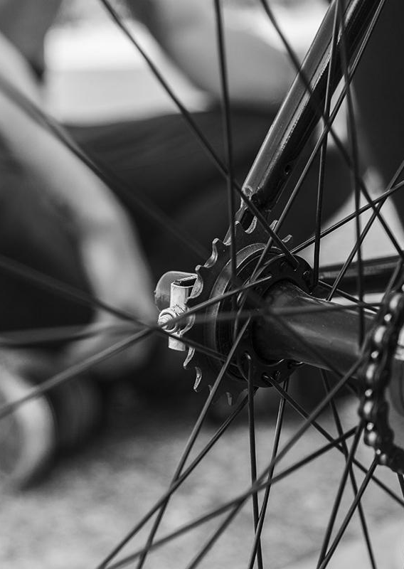
Project Background
Until now, Cyclistic’s marketing strategy
relied on building general awareness and
appealing to broad consumer segments.
They want to change their marketing
approach by utilizing data driven metrics
based on customer usage trends in order
to increase their membership base.

Slide 5
Understanding how Annual members and Casual riders use Cyclistic bikes differently using historical data.
OBJECTIVE
Notes:
Source of the dataset is from Internal Data obtained from Cyclistic’s historical monthly trip from the previous year (January – December, 2021). The data is a public data under the license (Data License Agreement | Divvy Bikes).

Slide 6
KEY STAKE HOLDRS
01
02
The Cyclistic Executives
The Director of Marketing
The Cyclistic Marketing Analytics Team
03

Slide 7
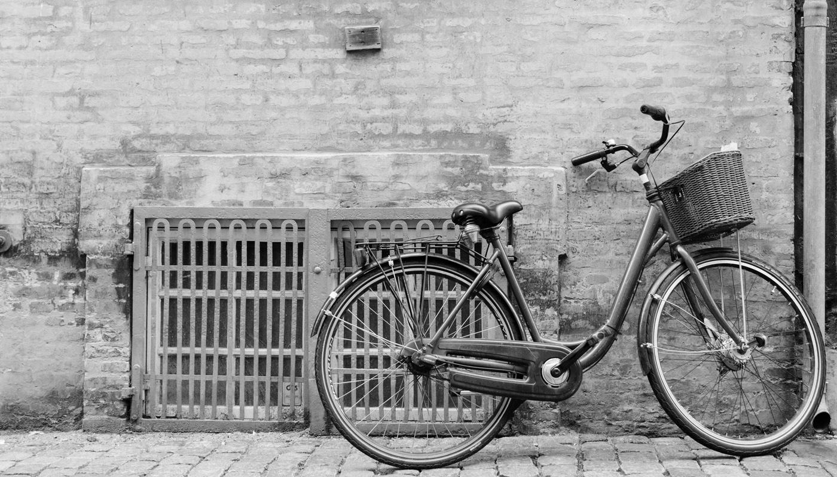
An image is worth a thousand words
Notes:
VISUALIZATIONS DONE USING TABLEAU (Profile - gabriel.baah | Tableau Public)

Slide 8
01
DETAILED ANALYSIS
BREAKDOWN OF USAGE TRENDS FOR CASUAL AND MEMBER USERS.
Notes:
There is readily downloadable data from (https://divvy-tripdata.s3.amazonaws.com/index.html).

Slide 9
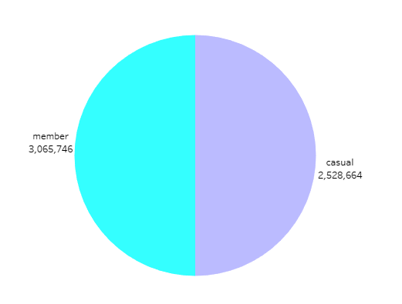
TARGET GROUP POTENTIAL
CUSTOMER POPULATION SIZES
45% of Cyclistic bike
Users are Casual users
which is equivalent to
about 2.5 million
potential members.
Notes:
The total bike usage recorded for the year was 5,594,410 out of which 3,065,746 (55%) were by Members and 2,528,664 (45%)were by Casual users. (Profile - gabriel.baah | Tableau Public)

Slide 10
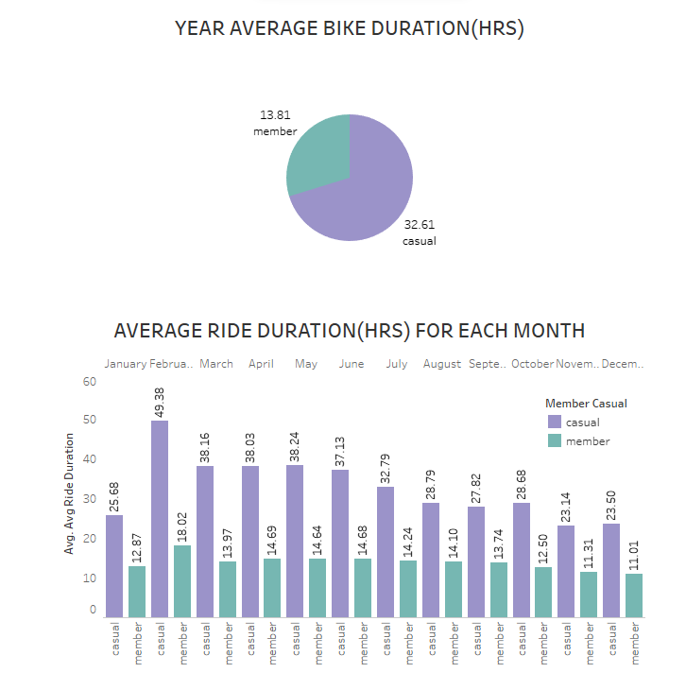
AVERAGE BIKE DURATION
Average ride duration for casual users for the year was 32.61 while members recorded 13.81.
The average ride duration is fairly consistent throughout the year with Casual riders recording significantly high averages.
Notes:
Profile - gabriel.baah | Tableau Public

Slide 11
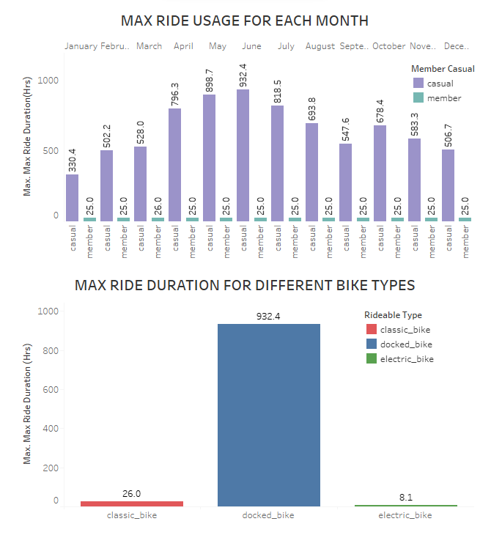
MAXIMUM RIDE DURATION
The highest recorded
Maximum ride duration
was 932 hours for
Casual users and 25.99
hours for member users
for the entire year.
Docked bike types had
the maximum ride
duration for the entire
year by Casual users.
Notes:
Profile - gabriel.baah | Tableau Public

Slide 12
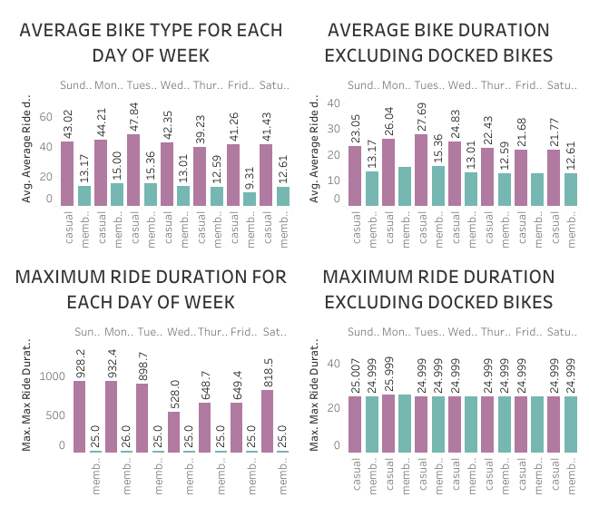
WEEKDAY BIKE USAGE
Consistently significant
difference in Averages
with Casual users
maintaining higher
averages with Tuesdays
recording the highest.
Mondays, Sundays and
Tuesdays recorded the
maximum ride duration
at 932 hours
Notes:
Profile - gabriel.baah | Tableau Public

Slide 13
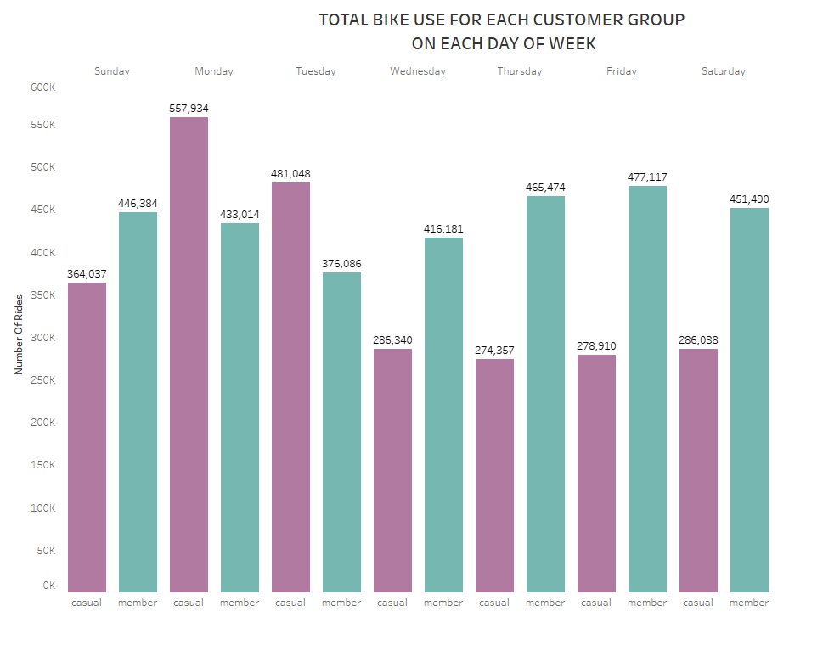
WEEKDAY BIKE USAGE
Casual users show
highest patronage on
Mondays and Tuesdays
while other days are
dominated by member users.
Notes:
Profile - gabriel.baah | Tableau Public

Slide 14
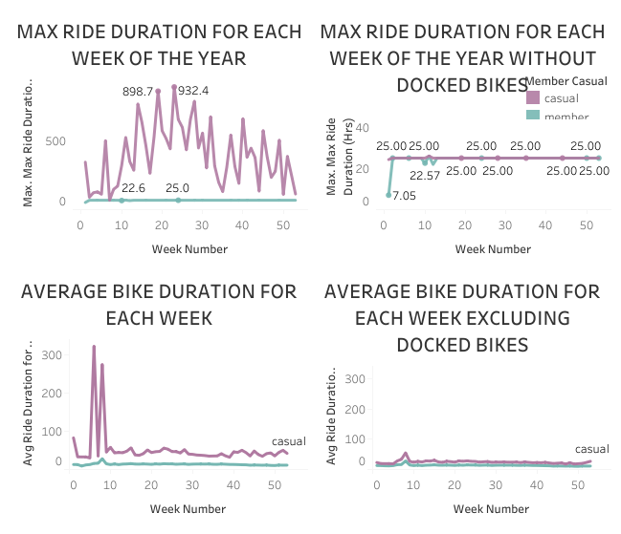
WEEKLY BIKE USAGE
Highest averages on the 6th
and 8th week for causal
riders but the other weeks
maintain significantly higher
consistent averages
compared to Member
averages which were fairly
consistent throughout the
weeks.

Slide 15
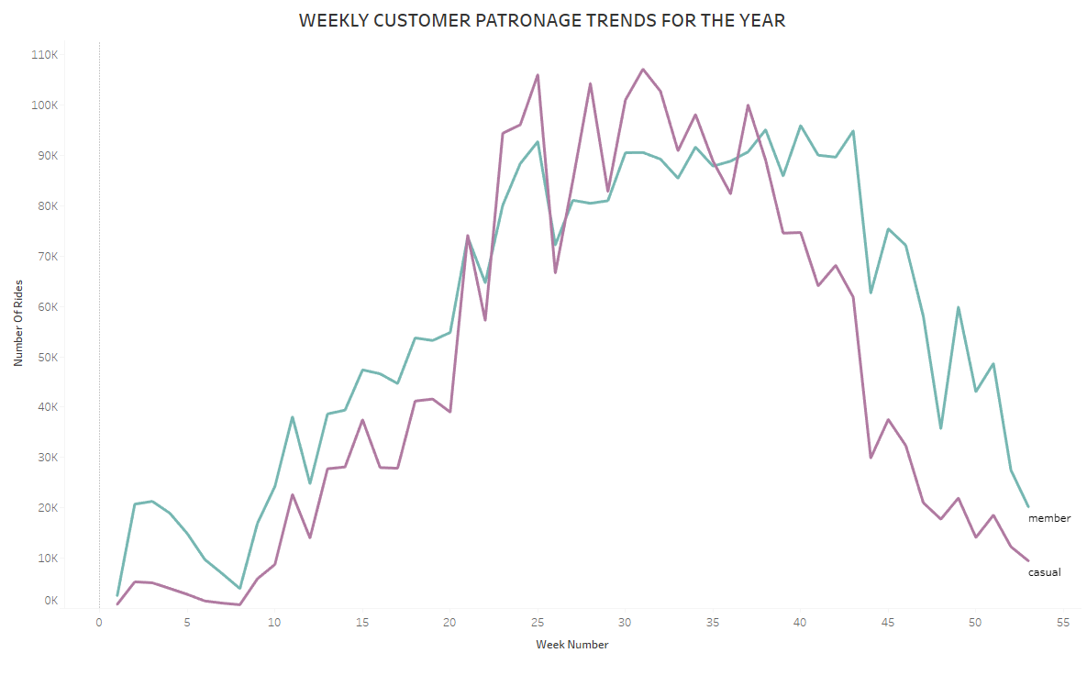
WEEKLY BIKE USAGE
Members show
consistently higher
patronage patterns
compared to Casual
users which changes
only in the middle part of
the year.
Notes:
Profile - gabriel.baah | Tableau Public

Slide 16
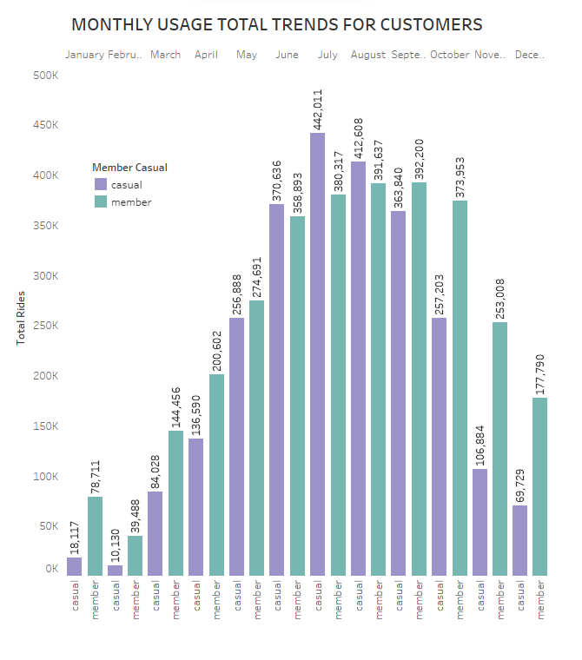
MONTHLY BIKE USAGE
There is a trend of low
figures from the start of
the year which rises,
significantly and peaks
towards the middle and
falls again towards the
end of the year.
Notes:
Profile - gabriel.baah | Tableau Public

Slide 17

RIDEABLE TYPE (BIKE TYPE) ANALYSIS

Slide 18
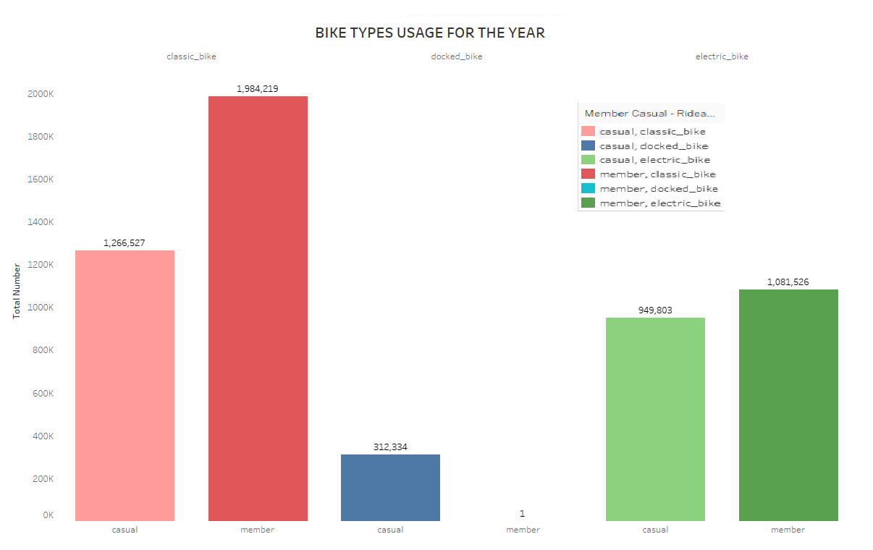
CLASSIC BIKE USAGE
Classic bike types had the highest usage for the entire year at 35.47% for member users and 22.64% for Casual users.
It had a slight decrease in patronage at the end of the year.
Notes:
Profile - gabriel.baah | Tableau Public

Slide 19
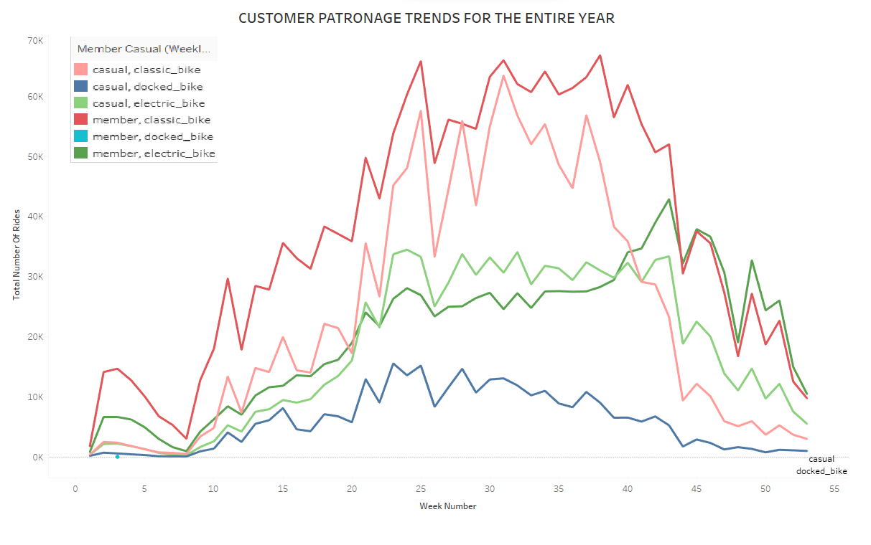
ELECTRIC BIKE USAGE
Electric bike types were the next highly patronized bike type for Members and Casuals at 19.33% for Members and 16.98% for Casual users.
Patronage increasing above classic bike types towards the end of the year.
Notes:
Profile - gabriel.baah | Tableau Public

Slide 20
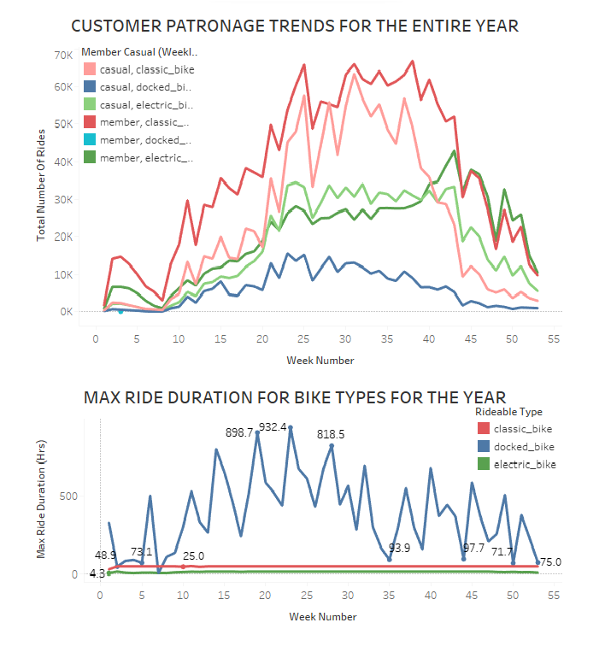
DOCKED BIKE USAGE
Docked type bike were the least preferred with patronage only from Casual riders at 5.58%.
Docked type bikes were ridden the longest distances while all other bike types showed similar average and maximum bike durations.
Notes:
Profile - gabriel.baah | Tableau Public

Slide 21
02
KEY FINDINGS FROM THE ANALYSIS
TRENDS AND PARTTERNS IDENTIFIED

Slide 22
Trends show seasonal influence in bike usage as similar usage patterns are visible for both member and casual users
01
Superseding casual user patronage may be due to inflow of tourists during the summer season and many outdoor events taking place in summer.
02

Slide 23
Consistent Maximum and Average bike use for both member and casual users excluding docked bikes show people mostly use it for commuting or for routine activities.
03
04
Docked bike users are all casual. Max ride duration for docked bikes show they are mostly use it for long periods which show great potential to make them members.

Slide 24
Electric bike users had significant numbers as there was consistency in patronage for both casual and member users hence a good source of potential members.
05
06
Further investigation is required to reveal why Docked bike users had so high averages and maximum ride duration since usage patterns are similar with the exclusion of docked bikes.

Slide 25
03
RECOMMENDATIONS
KEY NOTES TO CONSIDER FOR MARKETING

Slide 26
Marketing should factor in seasonal trends and Seasonal memberships should be considered to target seasonal users as data evidently shows
01
Marketing should be tailored to different bike type users especially Dock type users as our member users don’t like docked bikes.
02

Slide 27
Marketing should target the everyday people like commuters or people having routine schedules traveling over short distances or people who like to keep bicycles as a main commuting means (docked type users)
03

Slide 28
Thank you
CONTACT INFO:
tebrigabby@gmail.com
Notes:
GOOGLE DATA ANALYTICS CERTIFICATION CAPSTONE PROJECT – 2022. (TEMPLATE FROM SLIDESGO).

